Slide 1
Computer Organization
CSE 230 Computer Organization
Lecture 3
Computer Architecture and Organization
© Gamal Fahmy

Slide 2
Architecture and Organization
Architecture deal with design aspects outside the micro processor, or in the micro processor interface
Organization deals with totally inside processor aspects

Slide 3
Computer Architecture and Organization
Execution time for any program depends on:
  Number of inst.
  Avg. clock cycle per inst.
  Time per clock cycle
Architecture
Organization
IC_Technology
MAR
MDR
These factors are inter related
ALU
PC
IR
Control Unit
General Purpose Registers
I/O units

Slide 4
Architectures
Different architectures would affect the program instructions.
Sample programs
    Load A load A, B
    Add B Add
    Stop Sub C, B
Size of the data bus would affect if the instruction would be fetched on one cycle or more. A 16-bit instruction would be fetched on 2 cycles on an 8-bit data bus.

Slide 5
Organization of a Micro-processor
Each instruction consists of an opcode and an operand
The opcode gets decode into 1’s and 0’s to be sent by the control unit to different units
The operand is the variable that the opcode would be executed upon
If each is for example 8 bit long, then every instruction would be 16 bit long
Every instruction is split down into micro-instructions, this would be dependent on the organization, as follows
OPCODE
OPERAND

Slide 6
Organization of a Micro-processor
Example:
    Load A (A is memory location)
        Move A into MAR
        Send read signal to Memory
        Move data from MDR to one of the micro processor registers
    Add B (according to the architecture in Lab 5)
        Move B to MAR
        Send a read signal
        Move B to the ALU input, send add bits to the ALU
        Move output through accumulator to one of CPU registers

Slide 7
Fetch and Execute
Every opcode gets fetched while an operand gets executed
Fetch means bringing the opcode from memory and decoding it into machine code through the IR
Execute means executing the previous opcode upon the operand

Slide 8
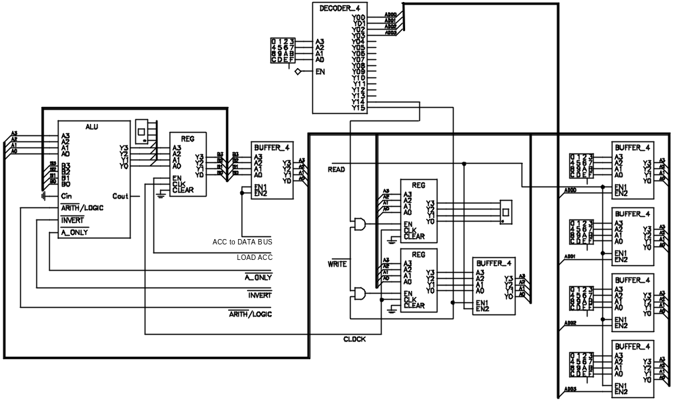
Brainless Micro processor
0
3
3
1
3
3
3
Pass
Through
0
5
1
0
1
X

Slide 9
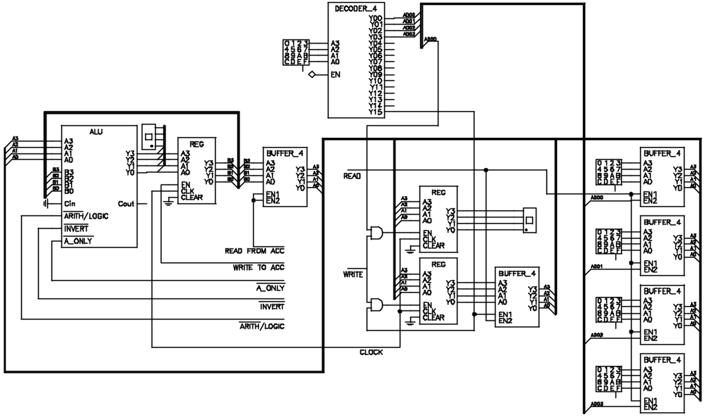
Brainless Micro processor
1
5
D
1
8
8
3
8
3
Sum
(ADD)
0
5
1
1
1
0

Slide 10
Program Concept
Hardwired systems are inflexible
General purpose hardware can do different tasks, given correct control signals
Instead of re-wiring, supply a new set of control signals

Slide 11
What is a program?
A sequence of steps
For each step, an arithmetic or logical operation is done
For each operation, a different set of control signals is needed

Slide 12
Function of Control Unit
For each operation a unique code is provided (micro instruction, check CSEN 401)
  e.g. ADD, MOVE
A hardware segment accepts the code and issues the control signals
We have a computer!

Slide 13
Components
The Control Unit and the Arithmetic and Logic Unit constitute the Central Processing Unit
Data and instructions need to get into the system and results out
  Input/output
Temporary storage of code and results is needed
  Main memory

Slide 14
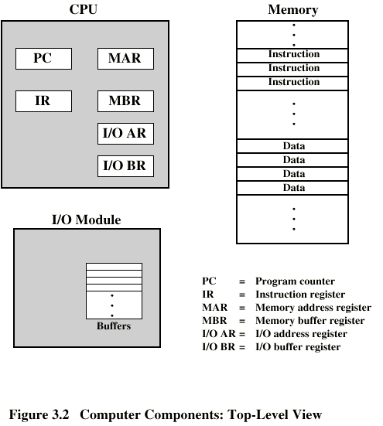
Computer Components:
Top Level View

Slide 15

Instruction Cycle
Two steps:
  Fetch
  Execute

Slide 16
Fetch Cycle
Program Counter (PC) holds address of next instruction to fetch
Processor fetches instruction from memory location pointed to by PC
Increment PC
  Unless told otherwise
Instruction loaded into Instruction Register (IR)
Processor interprets instruction and performs required actions

Slide 17
Execute Cycle
Processor-memory
  data transfer between CPU and main memory
Processor I/O
  Data transfer between CPU and I/O module
Data processing
  Some arithmetic or logical operation on data
Control
  Alteration of sequence of operations
  e.g. jump
Combination of above

Slide 18
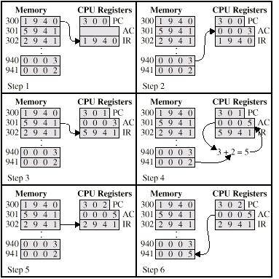
Example of Program Execution

Slide 19
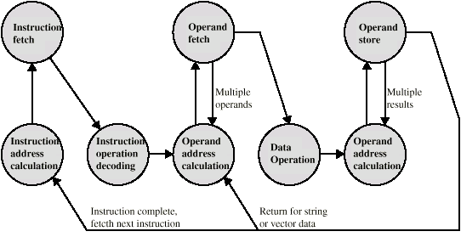
Instruction Cycle -
State Diagram

Slide 20
Computer Architecture and Organization
Execution time for any program depends on:
  Number of inst.
  Avg. clock cycle per inst.
  Time per clock cycle
Architecture
Organization
IC_Technology
MAR
MDR
These factors are inter related
ALU
PC
IR
Control Unit
General Purpose Registers
I/O units
© Gamal Fahmy

Slide 21
Architecture and Organization
Architecture deal with design aspects outside the micro processor, or in the micro processor interface
Organization deals with totally inside processor aspects
For multiply, if it means there is a hardware multiplier, then it is an architectural issue, if it will result in repeated additions it will be an organizational issue.
© Gamal Fahmy

Slide 22
Computer Architecture and Organization
Computer Architecture is defined as the science and art of selecting and interconnecting hardware components to create computers that meet functional, performance and cost goals (John Hennessy)
Computer Organization is defined as the implementation of these blocks and how each block functions independently
I can have 2 computers that have the same processor brand, same number of internal register, same instruction set, same format for operand in both memory and CPU registers, but they have different memory sizes, different processor frequency, different bus structure between the CPU and memory and I/O devices, and different instruction execution time.
© Gamal Fahmy

Slide 23
Readings
Hennessey Book page 1-30
Ch1, mazidi book
Stalling Book, page 1-30
© Gamal Fahmy

